Slide 1
DISASTER MANAGEMENT
Orientation bvpieee:
SNAKE-BOT

Slide 2
Problems-
Hard to reach places like narrow holes or paths made in natural calamities like earthquake.
Traversing in all types of terrain.
Rescuing buried people in avalanche, earthquake, etc.
Drugs trafficking through tunnels.
Accidents in Industries due to Gas Leak

Slide 3
HOW TO SOLVE Them ?

Slide 4
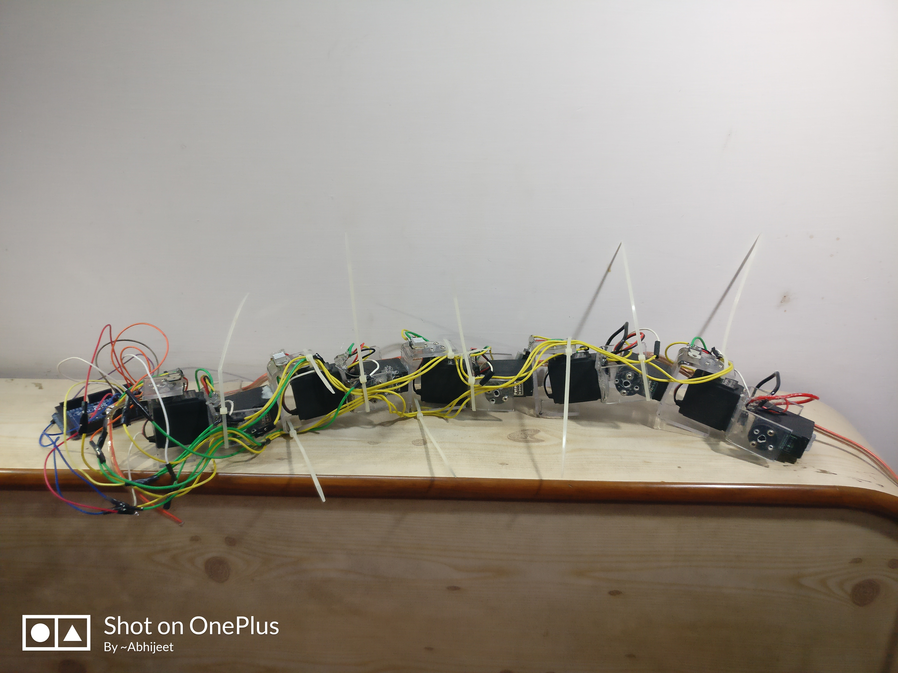
Snake-bot

Slide 5
FEATURES
Flexible
In-built location tracker for rescue purpose.
Gas sensor to detect gas leaks.
Cost efficient.
Wireless.
Camera for live video feeds.

Slide 6
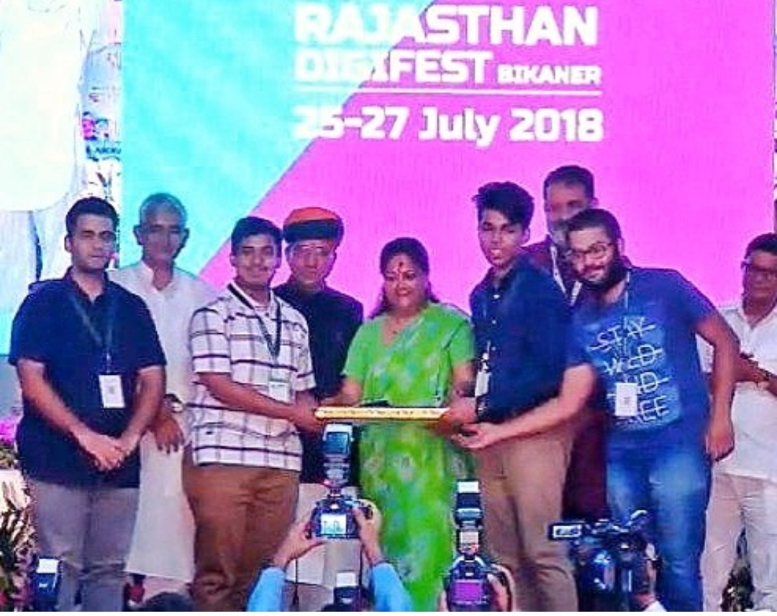

Slide 7
By-
ABHIJEET , TARUN , ARPIT ,
PRACHI AND PRANJAL

